Slide 1
For some joint probability distribution over a set of variables , Pr(X)
The dependencies between the X_{i} can be represented as a graph. An example for a 5-variable distribution Pr(A,B,C,D,E)
A
B
A 5-variable PMF with dependencies represented by an undirected graph (Markov Random Field)
E
C
D

Slide 2
Parameterize this distribution using unary potentials for each node and pair-wise potentials between each pair of connected nodes
For the example Pr(A,B,C,D,E) this amounts to replacing the undirected graph with a factor graph
A
B
Ψ_{A}
Ψ_{AB}
Ψ_{B}
Ψ_{AC}
Ψ_{BE}
Ψ_{AE}
Ψ_{BC}
E
C
Ψ_{E}
Ψ_{AD}
Ψ_{BD}
Ψ_{C}
Ψ_{ED}
Ψ_{CD}
D
Ψ_{D}

Slide 3
The Ψ_{i} and Ψ_{ij} are factors or potentials. They are functions representable in table form which hold un-normalized quantities which contribute to the probability distribution:
Ψ_{i} are called unary or node potentials and Ψ_{ij} are called pair or edge potentials.
Edge potentials are known as transfer matrices in statistical physics
Z is the normalization constant called the partition function
For the example Pr(A,B,C,D,E):

Slide 4
It will be convenient to actually parameterize the probability distribution in terms of the logarithms of the potentials:
Making an analogy with physics, log potentials are like energies associated with particles in a many-body system
ψ_{i}: Energies of the particle at node i to be in it’s various possible states.
In the Ising model of a magnet, the particle is an electron and it’s possible states are +1 (“spin up”) and -1 (“spin down”) so:

Slide 5
Making an analogy with physics, log potentials are like energies associated with particles in a many-body system
ψ_{ij}: Energies between particles at node i and j which directly feel each other.
In the Ising model:
For these reasons we’ll refer to log potentials as one-body (node) and two-body (edge) energies

Slide 6
The variable X_{i} are discrete but can take on any number of states (levels) s_{i}
Ising-like model: Two possible states: {s₁, s₂}
Potts-like model: More than two possible states {s₁, s₂, …, s_{m}}
To computationally operational-ize these ideas, it is convenient to define a “feature function”
w is a vector of weights for each state
I is a vector function which acts like a switch; indicator function
I selects out the weight for the state X_{i} = s_{Xi}
In physics feature functions are related to spinors which have a deep mathematical theory

Slide 7
As an example, lets say:
Then:
For the Ising model in physics it’s a little different:
Which leads to features:

Slide 8
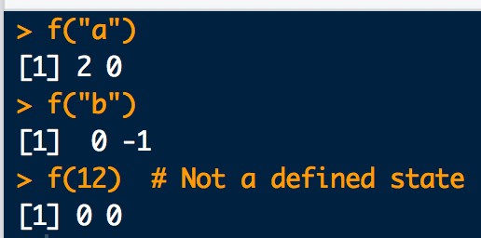
Here is how you implement feature functions in R:
# Make up some state lables:
s1 <- "a"
s2 <- "b"
# Define a weight vector:
w <- c(2,-1)
# Define feature function:
f <- function(y){ w * as.numeric(c((y==s1),(y==s2))) }
# Try it out:
f("a")
f("b")
# What happens for an undefined state
f(12)

Slide 9
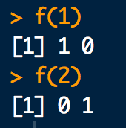
We usually define the feature function this way to work with CRF output:
# State labels used by CRF:
s1 <- 1
s2 <- 2
# Define feature function. State weights are implicitly 1:
f <- function(y){ as.numeric(c((y==s1),(y==s2))) }
# Try it out:
f(1)
f(2)
Compare with example two-slides ago

Slide 10
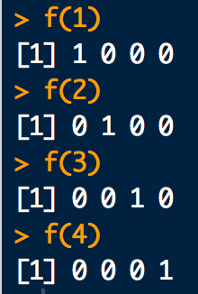
Feature function for a Potts-like model is the same idea:
# Define 4 state labels for a Potts-like model:
s1 <- 1
s2 <- 2
s3 <- 3
s4 <- 4
# Define feature function. State weights are implicitly 1:
f <- function(y){ as.numeric(c((y==s1),(y==s2),(y==s3),(y==s4))) }
# Try it out:
f(1)
f(2)
f(3)
f(4)

Slide 11
Using feature functions we can write node and edge energies in convenient matrix-vector form(s):
node energies
is called the node i weight vector:
If w = id(m) (all ones vector) then has entries numerically equivalent to node i energies

Slide 12
Using feature functions we can write node and edge energies in convenient matrix-vector form(s):
edge energies
is called the edge ij weight matrix:
If w = id(m) (all ones vector) then has entries numerically equivalent to edge ij energies

Slide 13
For the models considered here there will only be 2 states at each node. Also each state has weight 1. That is:
Thus the node and edge weights are:
The corresponding node and edge energies in table form are:

Slide 14
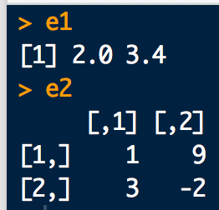
Here is how one and two-body energy calculations can be implemented in R:
# Consider an Ising-like model with:
tau <- c(2, 3.4) # node weights
omega <- rbind( # edge weights
c(1,9),
c(3,-2)
)
# Define states and feature function:
s1 <- 1
s2 <- 2
f <- function(y){ as.numeric(c((y==s1),(y==s2))) }
# one-body energies:
e1 <- c(f(1) %*% tau , f(2) %*% tau)
e1
# two-body energies
e2 <- rbind(
c(f(1) %*% omega %*% f(1), f(1) %*% omega %*% f(2)),
c(f(2) %*% omega %*% f(1), f(2) %*% omega %*% f(2))
)
e2

Slide 15
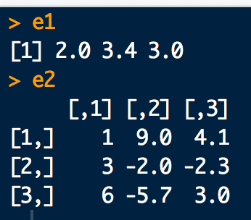
Again, for a Potts-like model things are pretty similar:
#Consider an Potts-like model with node/edge weights:
tau <- c(2, 3.4, 3)
omega <- rbind(
c(1, 9, 4.1),
c(3, -2, -2.3),
c(6, -5.7, 3 )
)
# Define states and featur function:
s1 <- 1
s2 <- 2
s3 <- 3
f <- function(y){ as.numeric(c((y==s1),(y==s2),(y==s3))) }
# one-body energies:
e1 <- c(f(1) %*% tau, f(2) %*% tau, f(3) %*% tau)
e1
# two body energies
e2 <- rbind(
c(f(1) %*% omega %*% f(1), f(1) %*% omega %*% f(2), f(1) %*% omega %*% f(3)),
c(f(2) %*% omega %*% f(1), f(2) %*% omega %*% f(2), f(2) %*% omega %*% f(3)),
c(f(3) %*% omega %*% f(1), f(3) %*% omega %*% f(2), f(3) %*% omega %*% f(3))
)
e2

Slide 16
Finally the node and edge potentials are:
With these components we can write the full joint probability distribution as:
Note, this is the same for Ising and Potts-like models.

Slide 17
The term in the exponential is the configuration energy E(X)
The sums are not actually sums over vectors/matrices. Rather they are sums of individual one and two-body components of energy corresponding to the states of variables in X.
To make this formula more explicit:
i > j is implicit
In physics E(•) is called the Hamiltonian

Slide 18
Compute the E(X) for all node state configurations
B
A
C

Slide 19
For this graph, the energy function is:
one-body energy
two-body energy

Slide 20
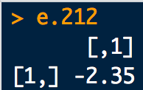
# node weights:
tauA <- c( 1, -1.3)
tauB <- c(-0.85, -2.4)
tauC <- c(3.82, 1.4)
# edge weights:
omegaAB <- rbind(
c( 3.5, -1.4),
c(-1.4, 2.5)
)
omegaBC <- rbind(
c( 2.6, 0.4),
c( 0.4, 2.5)
)
omegaAC <- rbind(
c(-0.6, 1.2),
c( 1.2, -0.6)
)
# Define states and feature function:
s1 <- 1
s2 <- 2
f <- function(y){ as.numeric(c((y==s1),(y==s2))) }
# Enumerate all the state configurations
config.mat <- expand.grid(c(s1,s2),c(s1,s2),c(s1,s2))
colnames(config.mat) <- c("A","B","C")
config.mat
# Energy(A=2,B=1,C=2)
e1.212 <- f(2)%*%tauA + f(1)%*%tauB + f(2)%*%tauC
e2.212 <- f(2)%*%omegaAB%*%f(1) + f(1)%*%omegaBC%*%f(2) + f(2)%*%omegaAC%*%f(2)
e.212 <- e1.212 + e2.212
e.212

Slide 21
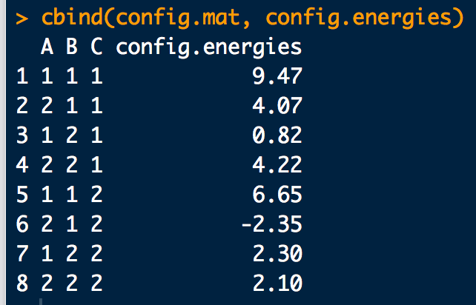
# To cut down on the amount of work we have to do, use CRFutil:
library(CRFutil)
# Define the edge connectivity matrix
edges <- rbind(
c(1,2), #AB
c(1,3), #AC
c(2,3) #BC
)
# Test: CRFutil function to compute a configuration energy.
config.energy(config = c(2,1,2),
edges.mat = edges,
one.lgp = list(tauA,tauB,tauC),
two.lgp = list(omegaAB,omegaAC,omegaBC), # use same order as edges!
ff = f)
# Define a convenience function wrapper:
ener.func <- function(config) {
engy <-config.energy(
config = config,
edges.mat = edges,
one.lgp = list(tauA,tauB,tauC),
two.lgp = list(omegaAB,omegaAC,omegaBC),
ff = f)
return(engy)
}
# Test:
ener.func(c(2,1,2))
# Use to compute all configuration energies:
config.energies <- sapply(1:nrow(config.mat), function(xx){ener.func(config.mat[xx,])})
cbind(config.mat, config.energies)

Slide 22
A short hand, but explicitly parameterized way to write the probability distribution is thus:
In physics this is usually called a Boltzmann distribution. In statistics and machine learning it is usually referred to as a Gibbs distribution
Since E(X) only contains up to two-body terms, this is also called a pair-wise Markov random field.
In order to really be able to use Pr(X), we need to know the partition function Z.
The un-normalized part is a product of potential terms (prodPot) and is often written as:

Slide 23
Sum all prodPots
Z is really hard to get in general because we have to sum over all configurations X. This gets large quickly with increasing number of nodes and increasing number of node-states.
For an Ising-like model with 20 variables there are 2²⁰ = 1048576 explicit terms in Z.
For a Potts-like model with 16 variables and 8 states per node (like a simple 4×4 8-bit image) there are 8¹⁶ = 2.81475 × 10¹⁴ explicit terms in Z.
Luckily, if the potentials are known or can be fit, there are various approaches that take advantage the graph structure for Pr(X) which can often be used to exactly or approximately compute Z.

Slide 24
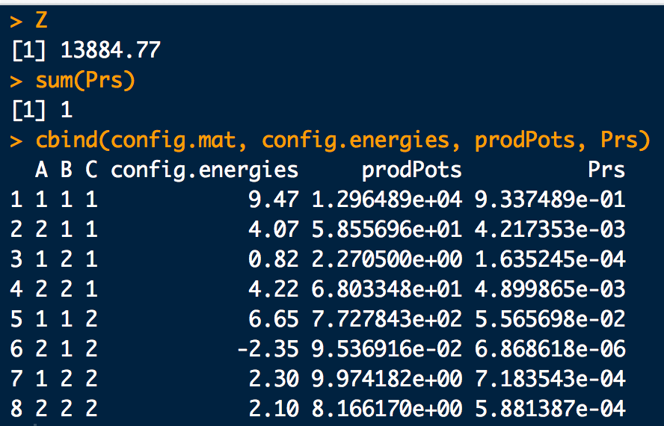
Example: Triangle
# Cf. slide 21 for input
# All configuration energies:
config.energies <- sapply(1:nrow(config.mat), function(xx){ener.func(config.mat[xx,])})
prodPots <- exp(config.energies) # Product Potentials
Z <- sum(prodPots) # The Partition function (by brute force...)
Prs <-prodPots/Z # Configuration probabilities
Z
sum(Prs)
cbind(config.mat, config.energies, prodPots, Prs)
B
A
C

Slide 25

Example: Schmidt Small
https://www.cs.ubc.ca/~schmidtm/Software/UGM/small.html
#The potentials for Cathy-Heather-Mark-Allison: 1-2-3-4
Psi1 <- c(0.25, 0.75)*4
Psi2 <- c(0.9, 0.1) *10
Psi3 <- c(0.25, 0.75)*4
Psi4 <- c(0.9, 0.1) *10
Psi12 <-
6*rbind(c(2/6, 1/6),
c(1/6, 2/6))
Psi23 <-
6*rbind(c(2/6, 1/6),
c(1/6, 2/6))
Psi34 <-
6*rbind(c(2/6, 1/6),
c(1/6, 2/6))
# Define states and feature function:
s1 <- "right"
s2 <- "wrong"
f <- function(y){ as.numeric(c((y==s1),(y==s2))) }
# Enumerate all the state configurations
config.mat <- expand.grid(c(s1,s2),c(s1,s2),c(s1,s2),c(s1,s2))
colnames(config.mat) <- c("Cathy", "Heather", "Mark", "Alison")

Slide 26
Example: Schmidt Small
https://www.cs.ubc.ca/~schmidtm/Software/UGM/small.html
library(CRFutil)
# Edge connectivity matrix
edges <- rbind(
c(1,2), #Cathy-Heather
c(2,3), #Heather-Mark
c(3,4) #Mark-Allison
)
# Define a convenience function wrapper:
ener.func <- function(config) {
engy <-config.energy(config = config, edges.mat = edges,
one.lgp = list(log(Psi1),log(Psi2),log(Psi3),log(Psi4)),
two.lgp = list(log(Psi12),log(Psi23),log(Psi34)), ff = f)
return(engy)
}
# All configuration energies:
config.energies <- sapply(1:nrow(config.mat), function(xx){ener.func(config.mat[xx,])})
prodPots <- exp(config.energies)
Z <- sum(prodPots)
Prs <-prodPots/Z
Z
sum(Prs)
cbind(config.mat, config.energies, prodPots, Prs)

Slide 27
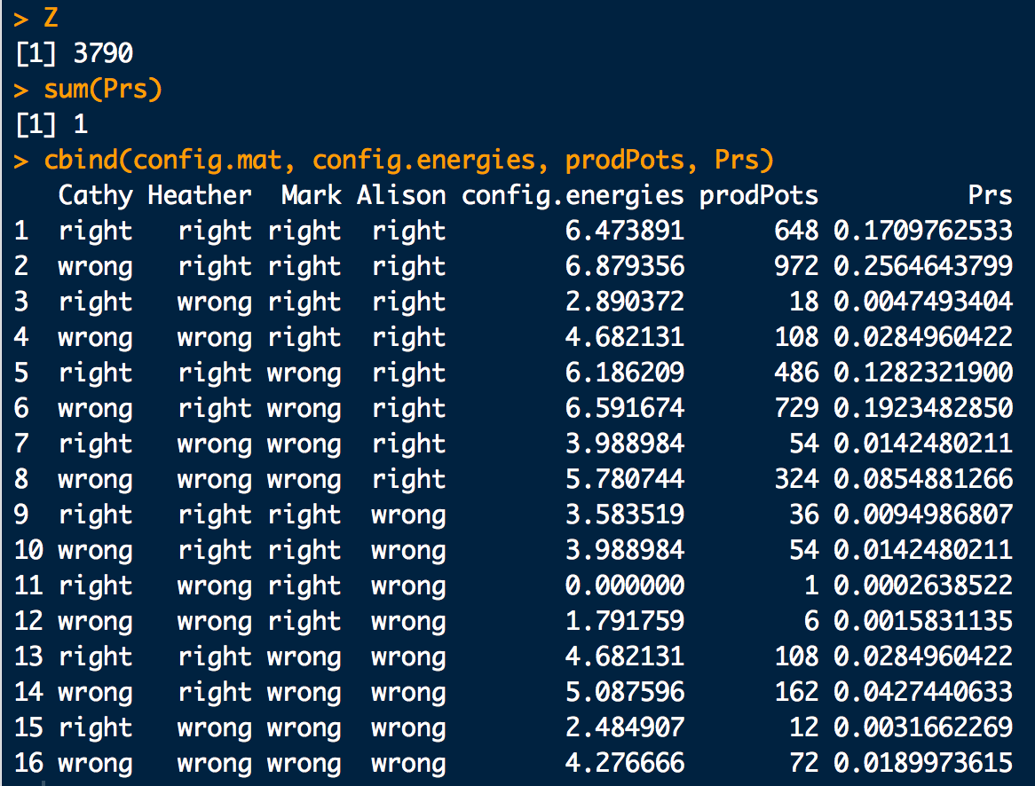
Example: Schmidt Small
https://www.cs.ubc.ca/~schmidtm/Software/UGM/small.html

Slide 28
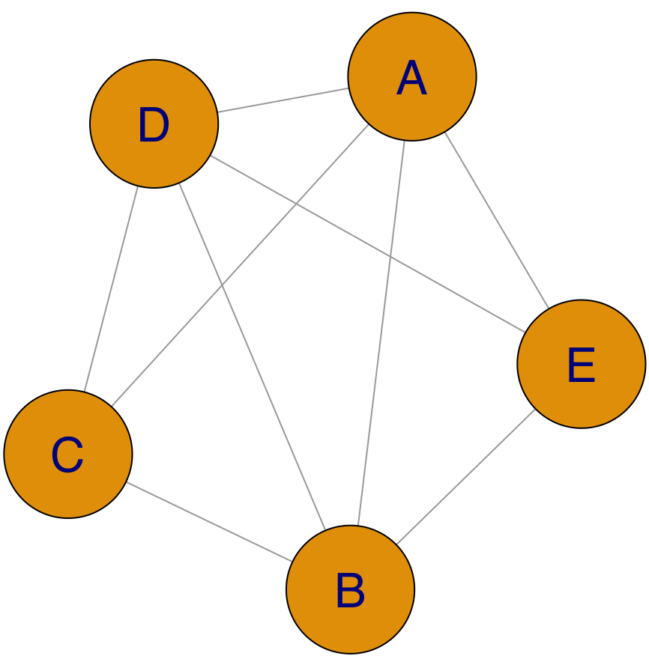
Example: Slayer field, more elaborate example.
A
B
This time we’ll assign potentials randomly and use CRFutil convenience functions:
E
C
D
library(CRFutil)
# Graph formula for Slayer field:
grphf <- ~A:B+A:C+A:D+A:E+B:C+B:D+B:E+C:D+D:E
# Check the graph:
gp <- ug(grphf, result = "graph")
dev.off()
iplot(gp)
# Adjacenty matrix:
adj <- ug(grphf, result="matrix")
# Define states and feature function:
s1 <- 1
s2 <- 2
f <- function(y){ as.numeric(c((y==s1),(y==s2))) }
# NEW! Make up random potentials and return a CRF-object
slay <- sim.field.random(adjacentcy.matrix=adj, num.states=2, num.sims=100, seed=1)$model

Slide 29
Example: Slayer field, more elaborate example.
# NEW: Get energies from potentials and decorate both with gRBase annotations:
slay.params <- make.gRbase.potentials(crf=slay, node.names=gp@nodes, state.nmes=c(s1,s2))
slay.node.en <- slay.params$node.energies
slay.edge.en <- slay.params$edge.energies
slay.node.pot <- slay.params$node.potentials
slay.edge.pot <- slay.params$edge.potentials
# Define states and feature function:
s1 <- 1
s2 <- 2
f <- function(y){ as.numeric(c((y==s1),(y==s2))) }
# Enumerate all the state configurations
config.mat <- expand.grid(c(s1,s2),c(s1,s2),c(s1,s2),c(s1,s2),c(s1,s2))
colnames(config.mat) <- c("A","B","C","D","E")
# NEW: Compute Probs of all configurations and logZ from energies:
dist.en.info <- distribution.from.energies(
state.space = config.mat,
edges.mat = slay$edges,
node.energies = slay.node.en,
edge.energies = slay.edge.en,
energy.func = config.energy,
ff = f)
Pr.en <- dist.en.info$state.probs
Pr.en
# NEW: As a check compute Probs of all configurations and logZ from potentials as well:
dist.pot.info <- distribution.from.potentials(
gRbase.node.potentials = slay.node.pot,
gRbase.edge.potentials = slay.edge.pot)
Pr.pot <- dist.pot.info$state.probs
Pr.pot

Slide 30
Example: Slayer field, more elaborate example.
# Check quick to make sure all config energies are the same between the two combination methods:
library(prodlim)
names(dimnames(Pr.pot))
order(names(dimnames(Pr.pot)))
Pr.pot2 <- as.data.frame(as.table(Pr.pot))
Pr.pot2
gR.idxs <- Pr.pot2[,order(names(dimnames(Pr.pot)))]
# Rearrange gR base state order to be in the same order as config.mat:
rearrange.idxs <- sapply(1:nrow(config.mat),
function(xx){row.match(config.mat[xx,], table = gR.idxs)})
rearrange.idxs
# Columns the same?
cbind(Pr.pot2[rearrange.idxs,6],Pr.en, Pr.pot2[rearrange.idxs,6]-Pr.en)
# Put in a nice table:
prodPots <- Pr.en*exp(dist.en.info$logZ) # work backwards
config.energies <- log(prodPots) # work backwards
cbind(config.mat, config.energies, prodPots, Pr.en, Pr.pot2[rearrange.idxs,6])

Slide 31
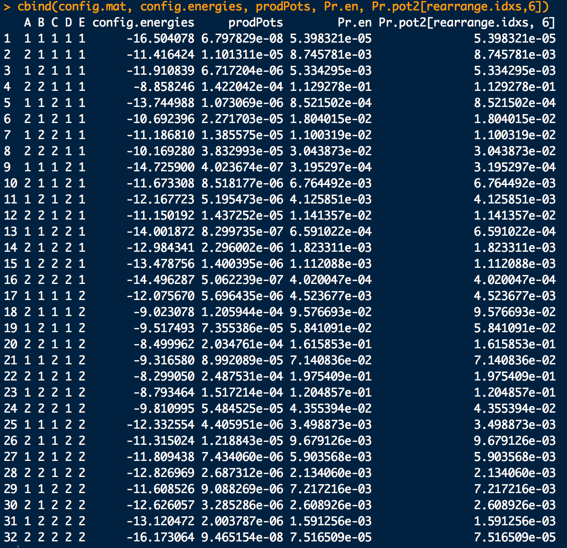
Example: Slayer field, more elaborate example.

Slide 32
So for this work, the problem then becomes determining the potentials
We will choose a standard parameterization:
Because any other choice for the second τ can be absorbed into Z
Assumes a symmetric edge weights and uses same trick as above for absorbing terms into Z
We can also choose a slightly more flexible parameterization: for where we allow the freedom for ω_{ij11} ≠ ω_{ij22}.
Note the τ_{i} and ω_{ij} are determined relative to the 0-terms

Slide 33
To estimate these parameters given data, the standard of practice is to Maximum Likelihood Estimation (MLE) or Maximum Pseudo-Likelihood Estimation (PS).
As an example of MLE consider the model in the standard parameterization:
B
A
C

Slide 34
For this model (as every other MRF):
The log-likelihood for a configuration X is proportional to:
The total log-likelihood for a sample of data (i.e. many X_{i}) is:

Slide 35
Lets say we observe the sample:
X₁ = (1,1,1)
X₂ = (1,2,1)
X₃ = (1,1,1)
The energies of each sampled configuration are:
Thus the total sample log-likelihood is:

Slide 36
Thus the total sample log-likelihood is:
MRF sufficient statistics: the number of times each parameter appears in the total log-likelihood
Having a sample of size N and a parameterized MRF model one can always compute the corresponding vector of sufficient statistics s
for this model
Collecting together the parameters of the MRF into a vector
for this model
we can represent the total log-likelihood as:

Slide 37
Under MLE we find the that maximizes :
The problem is we don’t know Z when we start the calculation…
We can solve the problem iteratively by re-computing Z after each time we adjust to the process of reaching
Z is prohibitive to re-compute for large networks, but we’ll use this method anyway.
We need to be careful not to let let the networks get too big…

Slide 38
In another approach to estimate the parameters, consider observing the state of all nodes in a configuration except for one, X_{i}.
The probability of X_{i} is:
That is, this is the probability of X_{i} conditioned on the state of all the other nodes
Within the MRF model this conditional is proportional to:
With:
we can express this conditional as:

Slide 39
This is logistic function on an binary random variable:
The likelihood of the MRF for an observation of a particular configuration can be a approximated as a product of these logistic representations:
Called a pseudo-likelihood for configuration X

Slide 41
The total likelihood for a sample of configurations (N of them) is then approximately:
Taking the log:

Slide 42
Summary:
Total log-likelihood for sample:
Pseudo log-likelihood for a configuration:
Total pseudo log-likelihood for sample:

Slide 45
??????????????????

Slide 48
B
B
A
C
A
C
B
A
C

Slide 49
Logistic regression for A????
B
A
C

